Slide 1
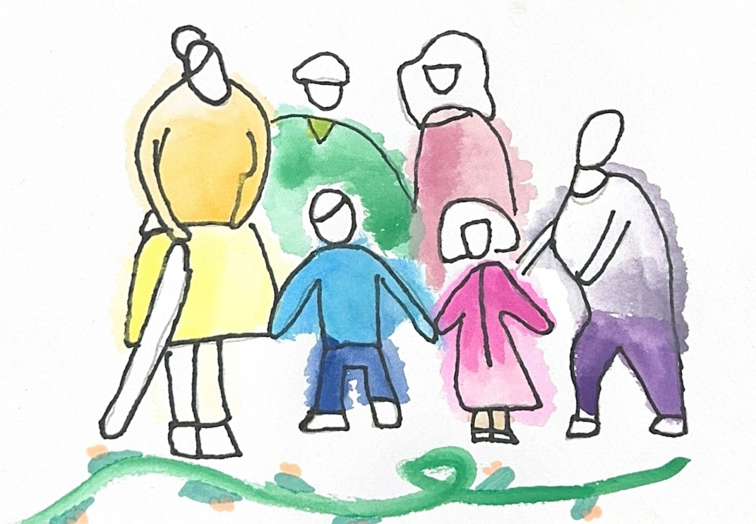

Created for Respectful Relationships
Conversations for Catholic schools
Session 1
Daryl Higgins, Gabby Hunt, Janine Luttick, Jamie Calder
Thursday 5th November 2026
In partnership with
© ACU, 2026

Slide 2
Session 1
Why Respectful Relationships matter in Catholic schools
-
Mission, reality and responsibility
© ACU, 2026

Slide 3
Welcome and participation choices
Participate in ways that are professionally useful and personally safe.
You may pass on any activity, pause, or step out without explanation.
Do not identify students, families, colleagues or yourself through personal disclosures.
This is a professional learning space, not a counselling or disclosure space.
If a concern about a child or young person arises, usual safeguarding and reporting procedures apply.
© ACU, 2026
Notes:
Today’s session deals with relationships, consent, safety and experiences of harm. You are invited to participate in ways that are professionally useful and personally safe. You may pass on any activity, step out without explanation, or speak with our nominated support person. Please do not share personal stories about students, colleagues or yourself in a way that identifies anyone. This is a professional learning space, not a disclosure or counselling space. If a concern about a child or young person arises, our usual safeguarding and reporting procedures apply.

Slide 4
Group agreements
Speak from your own perspective.
Protect privacy.
Challenge ideas, not people.
Avoid seeking or offering personal disclosures.
Notice the impact of language, not only its intent.
Follow safeguarding processes rather than trying to resolve concerns in the group.
??
© ACU, 2026
Notes:
Facilitator can request if other group agreements would like to be added.

Slide 5

Sensitive content warning & supports
Immediate danger: Call 000.
1800RESPECT: 1800 737 732.
Lifeline: 13 11 14.
13YARN: 13 92 76.
Employee Assistance Program: [SCHOOL TO INSERT].
Internal support contact: [SCHOOL TO INSERT].
Reporting concerns: [SCHOOL TO INSERT PROCESS/LINK].
Notes:
***SCHOOLS ARE ENCOURAGED TO POPULATE THIS SLIDE FOR THEIR CONTEXT***
As part of these Consent and Respectful Relationships Education resources, some content may reference experiences of gender-based violence, abuse, coercion, discrimination, or other sensitive topics.
We recognise that people bring a range of lived experiences to this space. We encourage you to engage in a way that supports your wellbeing, including stepping away if needed.
Thank you for helping create a respectful and supportive environment for all participants.

Slide 6
Session outcome
By the end of this session, we will be able to explain why Consent and Respectful Relationships Education is central to Catholic mission and safeguarding, rather than an add-on.
You may pass, pause or step out. Follow local safeguarding procedures. Support details available.
© ACU, 2026
Notes:
Welcome to the first session in our series.

Slide 7
Our core question
Why is Consent and Respectful Relationships Education central to Catholic education?
You may pass, pause or step out. Follow local safeguarding procedures. Support details available.
© ACU, 2026
Notes:
We begin by asking why Consent and Respectful Relationships Education matters in a Catholic school. Today is not about adding another isolated program. It is about considering how mission, safeguarding, teaching and culture meet in the everyday experience of students.

Slide 8

Watch the video
You may pass, pause or step out. Follow local safeguarding procedures. Support details available.
© ACU, 2026
Notes:
Video link:
https://www.youtube.com/watch?v=eQ-bYkLabUs

Slide 9
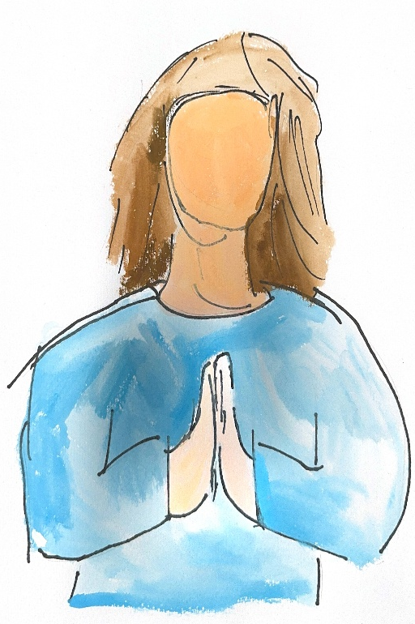
Pause and reflect
If a student learned about respectful relationships only by watching adults in our school, what would they learn?
What would they learn about dignity, power, listening, difference, boundaries, conflict, forgiveness, consent, asking for help and whose voice matters?
You may pass, pause or step out. Follow local safeguarding procedures. Support details available.
© ACU, 2026
Notes:
Please respond to these questions on the worksheet provided. Consider what students learn about relationships through school culture, identify areas of silence or inconsistency, and name a constructive opportunity for growth.
Respond only at a professional level. Do not name or describe identifiable students, families, colleagues or personal experiences. You may leave any section blank.

Slide 10
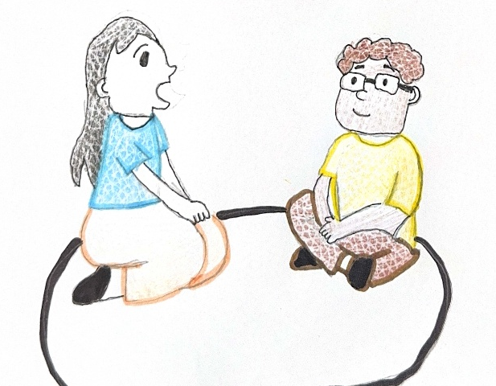
Reality check carousel
Station 1: Where do students currently learn about relationships?
Station 2: What messages might they receive outside school?
Station 3: Where might our school unintentionally stay silent?
Station 4: What are the risks of doing nothing or doing only the minimum?
Build on previous responses. Do not identify individuals.
You may pass, pause or step out. Follow local safeguarding procedures. Support details available.
© ACU, 2026
Notes:
There are four stations set up around the room. In groups you are going to spend approximately four minutes at each station, building on previous responses.
You may also like to record responses on your worksheet.
At the end of the time, each group will circle the observations that most need whole-staff attention, which you can also record on your worksheet.

Slide 11
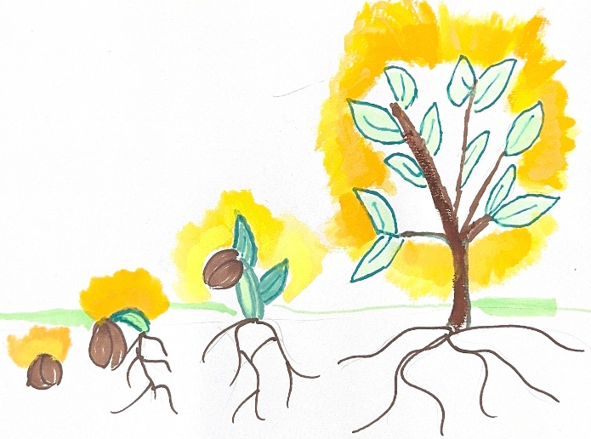
Whole – staff synthesis
What themes appeared at several stations?
Where is there tension between discomfort and responsibility?
What is one shared insight about our role?
You may pass, pause or step out. Follow local safeguarding procedures. Support details available.
© ACU, 2026
Notes:
Please answer these questions on the accompanying worksheet.

Slide 12

Name it to change it
One area where I think our school could grow in supporting safe and respectful relationships is…
You may pass, pause or step out. Follow local safeguarding procedures. Support details available.
© ACU, 2026
Notes:
Thank you for engaging thoughtfully. This work is not about having every answer or achieving perfection. It is about taking the next faithful, professionally responsible step together. Please complete your commitment card. The themes gathered today will be used only for the stated school improvement purpose, and we will communicate the next review point.

