Slide 1
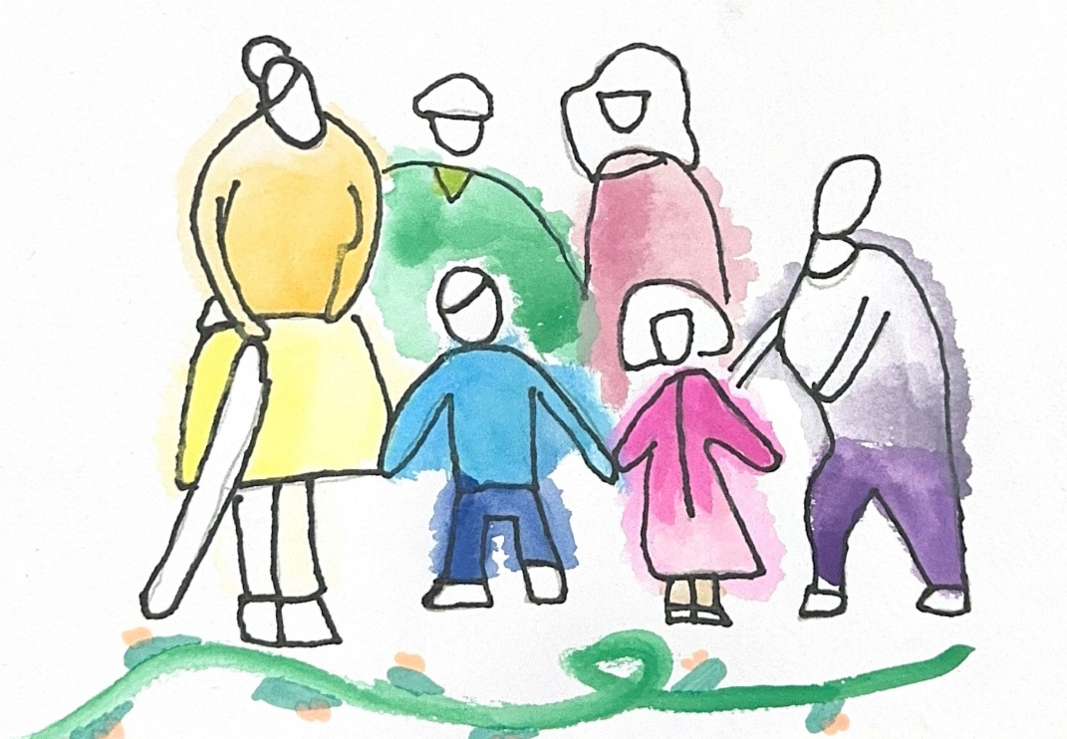

Created for Respectful Relationships
Conversations for Catholic schools
Session 2
Daryl Higgins, Gabby Hunt, Janine Luttick, Jamie Calder
Thursday 5th November 2026
In partnership with
© ACU, 2026

Slide 2
Session
2
Being and Becoming Human Together
-
Relational anthropology

Slide 3
Welcome and participation choices
Participate in ways that are professionally useful and personally safe.
You may pass on any activity, pause, or step out without explanation.
Do not identify students, families, colleagues or yourself through personal disclosures.
This is a professional learning space, not a counselling or disclosure space.
If a concern about a child or young person arises, usual safeguarding and reporting procedures apply.
© ACU, 2026
Notes:
Today’s session deals with relationships, consent, safety and experiences of harm. You are invited to participate in ways that are professionally useful and personally safe. You may pass on any activity, step out without explanation, or speak with our nominated support person. Please do not share personal stories about students, colleagues or yourself in a way that identifies anyone. This is a professional learning space, not a disclosure or counselling space. If a concern about a child or young person arises, our usual safeguarding and reporting procedures apply.

Slide 4
Group agreements
Speak from your own perspective.
Protect privacy.
Challenge ideas, not people.
Avoid seeking or offering personal disclosures.
Notice the impact of language, not only its intent.
Follow safeguarding processes rather than trying to resolve concerns in the group.
??
© ACU, 2026
Notes:
Facilitator can request if other group agreements would like to be added.

Slide 5
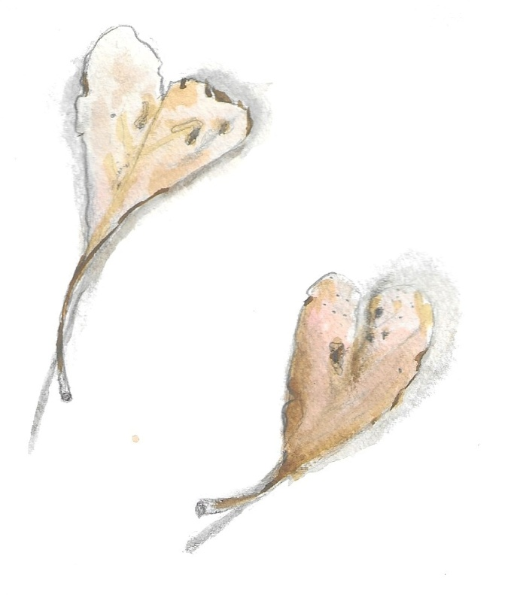
Sensitive content warning & supports
Immediate danger: Call 000.
1800RESPECT: 1800 737 732.
Lifeline: 13 11 14.
13YARN: 13 92 76.
Employee Assistance Program: [SCHOOL TO INSERT].
Internal support contact: [SCHOOL TO INSERT].
Reporting concerns: [SCHOOL TO INSERT PROCESS/LINK].
Notes:
***SCHOOLS ARE ENCOURAGED TO POPULATE THIS SLIDE FOR THEIR CONTEXT***
As part of these Consent and Respectful Relationships Education resources, some content may reference experiences of gender-based violence, abuse, coercion, discrimination, or other sensitive topics.
We recognise that people bring a range of lived experiences to this space. We encourage you to engage in a way that supports your wellbeing, including stepping away if needed.
Thank you for helping create a respectful and supportive environment for all participants.

Slide 6
Session outcome
By the end of this session, we will be able to connect a Catholic understanding of relationality with everyday educational practice.
You may pass, pause or step out. Follow local safeguarding procedures. Support details available.
© ACU, 2026
Notes:
Welcome to the second session in our series.

Slide 7
Our core question
What does it mean to be human in relationship?
You may pass, pause or step out. Follow local safeguarding procedures. Support details available.
© ACU, 2026
Notes:
In our first session, we considered why this work matters. Today we move underneath policies and programs to a deeper question: what does it mean to be human? We will explore the Catholic conviction that we become human together, through relationships marked by attention, care and responsibility.

Slide 8

Watch the video
You may pass, pause or step out. Follow local safeguarding procedures. Support details available.
© ACU, 2026
Notes:
Video link:
https://www.youtube.com/watch?v=KspvX1N_jOM

Slide 9
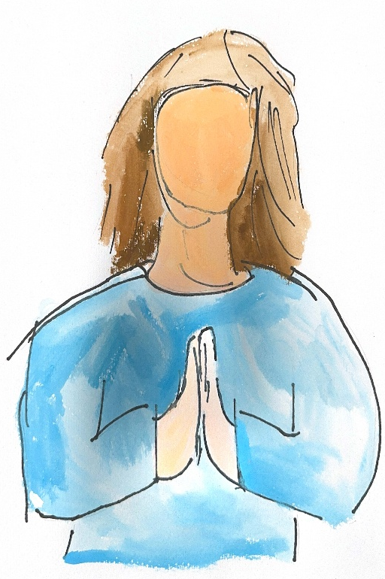
Pause and reflect
When do I feel most human and connected in my work?
When do I feel most disconnected?
What is one relational practice that makes a meaningful difference?
You may pass, pause or step out. Follow local safeguarding procedures. Support details available.
© ACU, 2026
Notes:
Please respond to these questions on the worksheet provided. Work with a fictional or generalised student. Do not identify a real student or disclose personal information. You may leave any section blank.

Slide 10
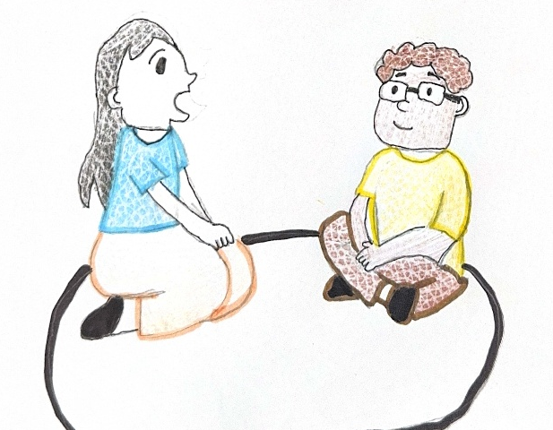
Mapping relationships
Place a student at the centre
Map four environments: peers; teachers and staff; family and community; online spaces
Identify influences, protective factors, risks and pressures
Mark where school has direct influence, indirect influence or little control
You may pass, pause or step out. Follow local safeguarding procedures. Support details available.
© ACU, 2026
Notes:
On a blank piece of paper write “Student” in the centre.
You may like to add notes under each environment on your worksheet to help you note your ideas.
We will then come together to read the whole map, noticing and discussing the following:
Where is connection strongest?
Where may a student experience pressure, exclusion or disconnection?
Where does school have the clearest opportunity to strengthen safety or belonging?
One small relational practice staff could use more consistently is…

Slide 11
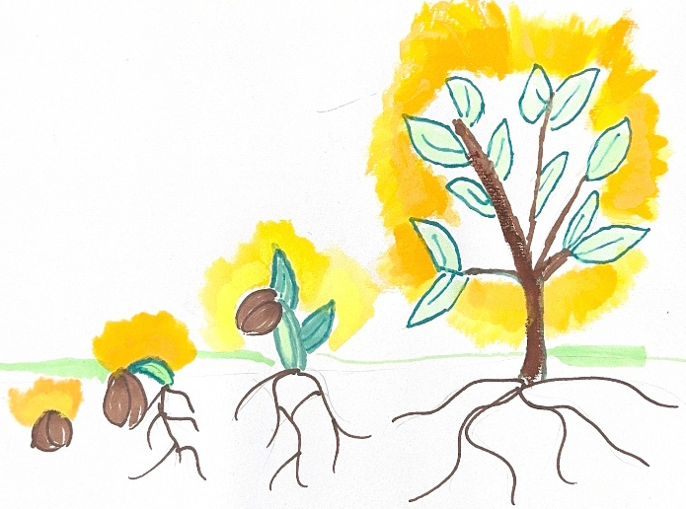
Whole – staff synthesis
What surprised us about the influences in a student’s world?
Where does school have the greatest opportunity to act?
What relational practice should become more consistent?
You may pass, pause or step out. Follow local safeguarding procedures. Support details available.
© ACU, 2026
Notes:
Please answer these questions on the accompanying worksheet.

Slide 12

Micro-relational practice
This week I will strengthen one small but intentional relational practice by…
(some examples of micro-practice)
Greet students by name
Learn something about a student beyond academics
Check in with a student is who often quiet or overlooked
Notice and affirm respectful behaviour
Pause and listen before responding
Follow up after a difficult interaction
You may pass, pause or step out. Follow local safeguarding procedures. Support details available.
© ACU, 2026
Notes:
Thank you for engaging thoughtfully. This work is not about having every answer or achieving perfection. It is about taking the next faithful, professionally responsible step together. Please complete your commitment card. The themes gathered today will be used only for the stated school improvement purpose, and we will communicate the next review point.

