Slide 1
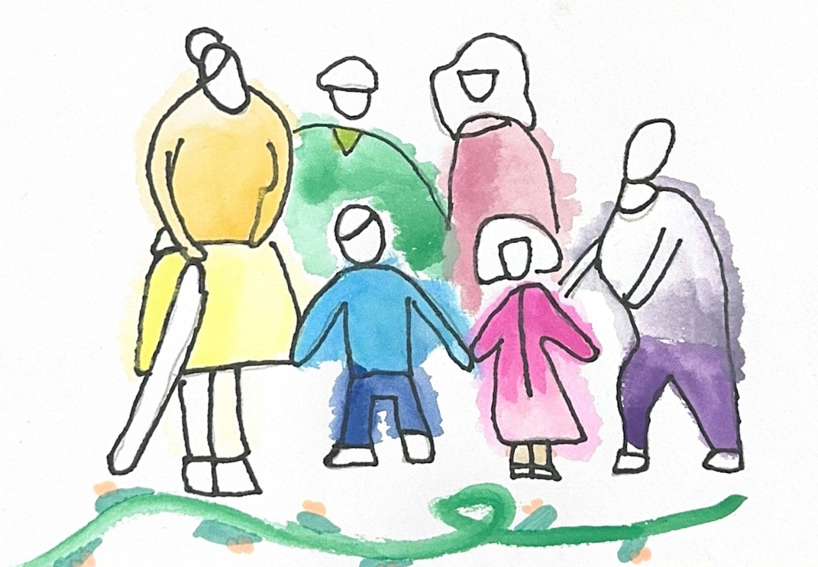

Created for Respectful Relationships
Conversations for Catholic schools
Session 3
Daryl Higgins, Gabby Hunt, Janine Luttick, Jamie Calder
Thursday 5th November 2026
In partnership with
© ACU, 2026

Slide 2
Session
3
Life and Life to the Full
-
Jesus, dignity and consent

Slide 3
Welcome and participation choices
Participate in ways that are professionally useful and personally safe.
You may pass on any activity, pause, or step out without explanation.
Do not identify students, families, colleagues or yourself through personal disclosures.
This is a professional learning space, not a counselling or disclosure space.
If a concern about a child or young person arises, usual safeguarding and reporting procedures apply.
© ACU, 2026

Slide 4
Group agreements
Speak from your own perspective.
Protect privacy.
Challenge ideas, not people.
Avoid seeking or offering personal disclosures.
Notice the impact of language, not only its intent.
Follow safeguarding processes rather than trying to resolve concerns in the group.
??
© ACU, 2026
Notes:
Facilitator can request if other group agreements would like to be added.

Slide 5

Sensitive content warning & supports
Immediate danger: Call 000.
1800RESPECT: 1800 737 732.
Lifeline: 13 11 14.
13YARN: 13 92 76.
Employee Assistance Program: [SCHOOL TO INSERT].
Internal support contact: [SCHOOL TO INSERT].
Reporting concerns: [SCHOOL TO INSERT PROCESS/LINK].
Notes:
***SCHOOLS ARE ENCOURAGED TO POPULATE THIS SLIDE FOR THEIR CONTEXT***
As part of these Consent and Respectful Relationships Education resources, some content may reference experiences of gender-based violence, abuse, coercion, discrimination, or other sensitive topics.
We recognise that people bring a range of lived experiences to this space. We encourage you to engage in a way that supports your wellbeing, including stepping away if needed.
Thank you for helping create a respectful and supportive environment for all participants.

Slide 6
Session outcome
By the end of this session, we will be able to use dignity, freedom, healing, restoration and accompaniment to evaluate school responses.
You may pass, pause or step out. Follow local safeguarding procedures. Support details available.
© ACU, 2026

Slide 7
Our core question
What do Jesus-inspired relationships look like in everyday school life?
You may pass, pause or step out. Follow local safeguarding procedures. Support details available.
© ACU, 2026
Notes:
Today we turn to Jesus as the Christian vision of fully human life. We will consider how dignity, freedom, healing, restoration and accompaniment can shape the way we understand consent and the way we respond to real situations in school life.

Slide 8

Watch the video
You may pass, pause or step out. Follow local safeguarding procedures. Support details available.
© ACU, 2026
Notes:
Video link:
https://www.youtube.com/watch?v=TomzeGJRm3k

Slide 9
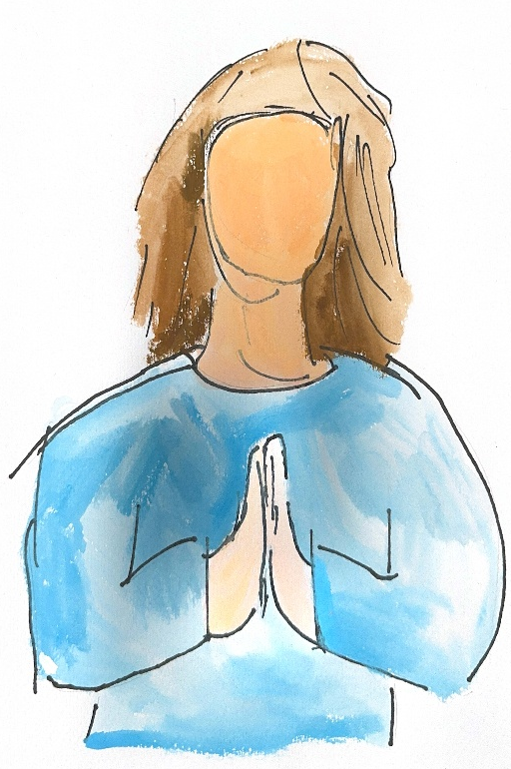
Pause and reflect
Recall a school moment when dignity was upheld or diminished. Do not record identifying details.
What made the difference?
How might healing, restoring or accompanying have changed the response?
You may pass, pause or step out. Follow local safeguarding procedures. Support details available.
© ACU, 2026
Notes:
Please respond to these questions on the worksheet provided. Do not record identifying details.
You may leave any section blank.

Slide 10
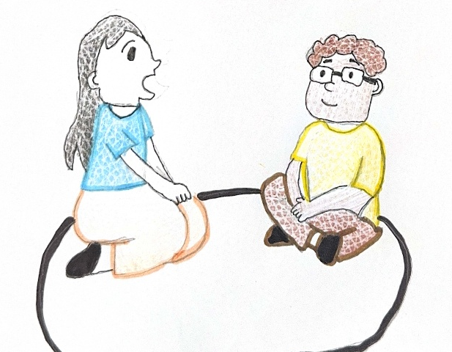
Gospel in Practice: task
Read your fictional scenario.
Name the immediate safety and policy response.
Compare a minimum response with a humanising, Jesus-inspired response.
Identify follow-up teaching, support and accountability.
You may pass, pause or step out. Follow local safeguarding procedures. Support details available.
© ACU, 2026
Notes:
Each group will be given one scenario.
Please remember that these are fictional fictional scenarios. Do not connect them to identifiable students or use the activity to resolve a current safeguarding matter. If there are current concerns that are raised through this activity, you must follow our school procedures.
You’ll be asked to compare a minimum response with a Jesus-inspired response shaped by healing, restoring and accompanying for your assigned scenario.
A student is pressured by peers to share an image.
A sexist joke is made in class and several students laugh.
A student is repeatedly excluded from a friendship group.
A student says they feel uncomfortable with a peer’s repeated messages.

Slide 11
Questions for each scenario
What must happen immediately for safety and policy compliance?
How will the response uphold dignity and agency?
How could relationships be restored while minimising harm?
What teaching, follow-up or support is needed?
Who needs to be involved through established processes?
You may pass, pause or step out. Follow local safeguarding procedures. Support details available.
© ACU, 2026
Notes:
Discuss in your group your responses for each of these questions. You may like to record these on your worksheet.

Slide 12
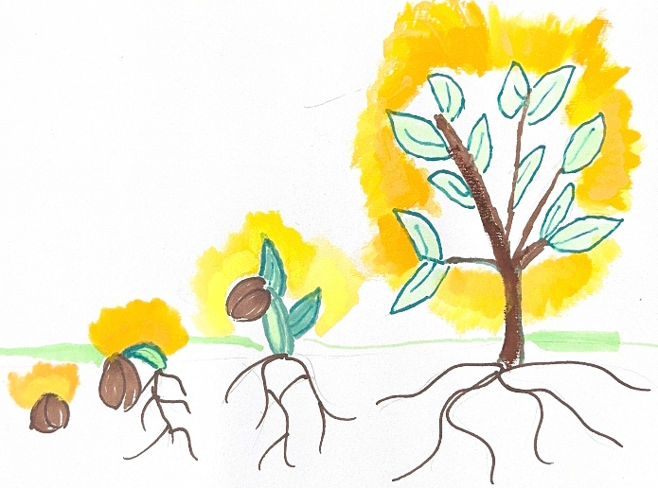
Whole-staff synthesis
What changed when we moved from a minimum response to a humanising response?
What does accompaniment look like without removing accountability?
What language should we use more consistently?
You may pass, pause or step out. Follow local safeguarding procedures. Support details available.
© ACU, 2026
Notes:
Please answer these questions on the accompanying worksheet.

Slide 13

Reframing question
Before I respond, I will ask:
Does my response support this student’s understanding of their own dignity and the dignity of others?
You may pass, pause or step out. Follow local safeguarding procedures. Support details available.
© ACU, 2026
Notes:
Thank you for engaging thoughtfully. This work is not about having every answer or achieving perfection. It is about taking the next faithful, professionally responsible step together. Please complete your commitment card. The themes gathered today will be used only for the stated school improvement purpose, and we will communicate the next review point.

