Slide 1
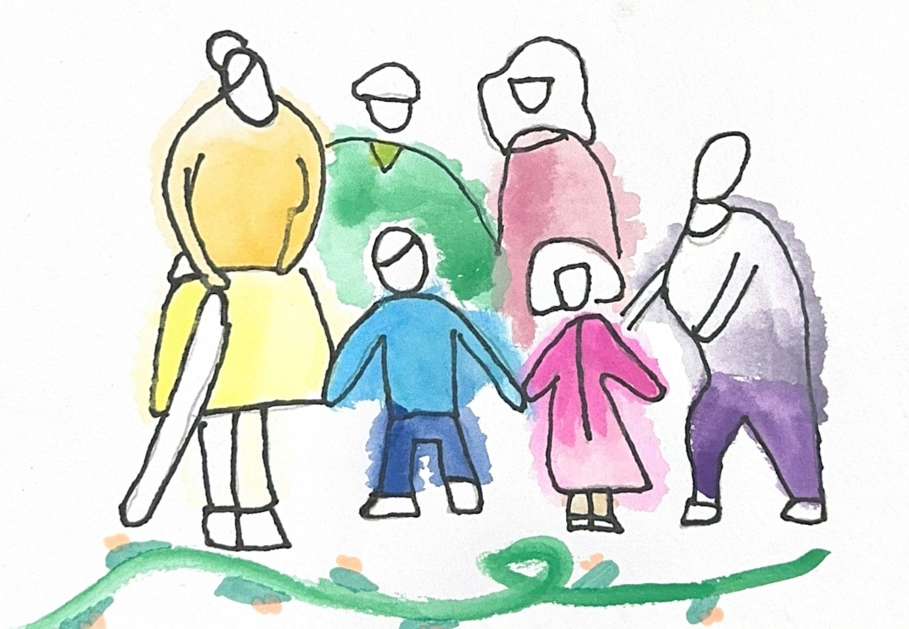

Created for Respectful Relationships
Conversations for Catholic schools
Session 4
Daryl Higgins, Gabby Hunt, Janine Luttick, Jamie Calder
Thursday 5th November 2026
In partnership with
© ACU, 2026

Slide 2
Session
4
Voice of the Child
-
Student voice, agency and safeguarding

Slide 3
Welcome and participation choices
Participate in ways that are professionally useful and personally safe.
You may pass on any activity, pause, or step out without explanation.
Do not identify students, families, colleagues or yourself through personal disclosures.
This is a professional learning space, not a counselling or disclosure space.
If a concern about a child or young person arises, usual safeguarding and reporting procedures apply.
© ACU, 2026
Notes:
Today’s session deals with relationships, consent, safety and experiences of harm. You are invited to participate in ways that are professionally useful and personally safe. You may pass on any activity, step out without explanation, or speak with our nominated support person. Please do not share personal stories about students, colleagues or yourself in a way that identifies anyone. This is a professional learning space, not a disclosure or counselling space. If a concern about a child or young person arises, our usual safeguarding and reporting procedures apply.

Slide 4
Group agreements
Speak from your own perspective.
Protect privacy.
Challenge ideas, not people.
Avoid seeking or offering personal disclosures.
Notice the impact of language, not only its intent.
Follow safeguarding processes rather than trying to resolve concerns in the group.
??
© ACU, 2026
Notes:
Facilitator can request if other group agreements would like to be added.

Slide 5
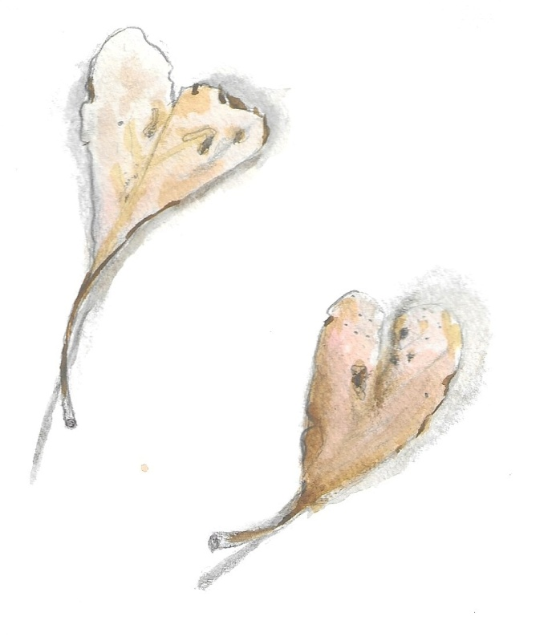
Sensitive content warning & supports
Immediate danger: Call 000.
1800RESPECT: 1800 737 732.
Lifeline: 13 11 14.
13YARN: 13 92 76.
Employee Assistance Program: [SCHOOL TO INSERT].
Internal support contact: [SCHOOL TO INSERT].
Reporting concerns: [SCHOOL TO INSERT PROCESS/LINK].
Notes:
***SCHOOLS ARE ENCOURAGED TO POPULATE THIS SLIDE FOR THEIR CONTEXT***
Today’s session deals with relationships, consent, safety and experiences of harm. You are invited to participate in ways that are professionally useful and personally safe. You may pass on any activity, step out without explanation, or speak with our nominated support person. Please do not share personal stories about students, colleagues or yourself in a way that identifies anyone. This is a professional learning space, not a disclosure or counselling space. If a concern about a child or young person arises, our usual safeguarding and reporting procedures apply.

Slide 6
Session outcome
By the end of this session, we will be able to identify how voice, agency, vulnerability and power shape safeguarding.
You may pass, pause or step out. Follow local safeguarding procedures. Support details available.
© ACU, 2026

Slide 7
Our core question
Whose voice is heard, and whose voice may be missing?
You may pass, pause or step out. Follow local safeguarding procedures. Support details available.
© ACU, 2026
Notes:
Today’s session asks whose voice is heard and whose voice may be missing. We will hold together two truths: children and young people have agency and insight, and they also need protection, guidance and care. Listening is not an optional courtesy. It is part of safeguarding.

Slide 8
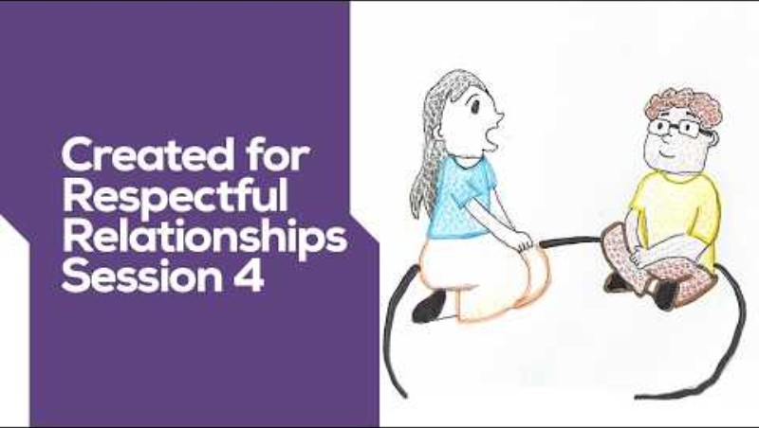
Watch the video
You may pass, pause or step out. Follow local safeguarding procedures. Support details available.
© ACU, 2026
Notes:
Video link:
https://www.youtube.com/watch?v=2aGlbAjPc5A

Slide 9
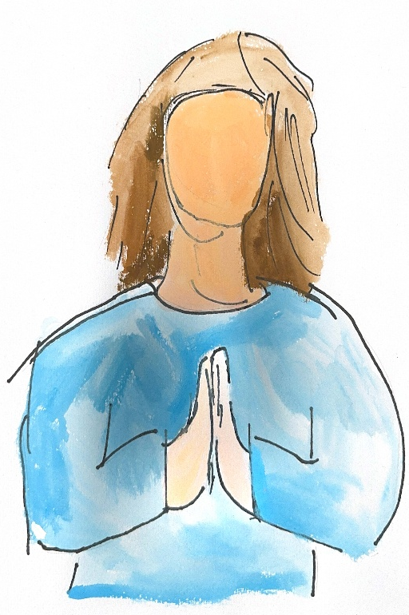
Pause and reflect
Without sharing personal details, when did you feel unheard at school?
What conditions made speaking possible or difficult?
What might this suggest about contemporary student voice?
You may pass, pause or step out. Follow local safeguarding procedures. Support details available.
© ACU, 2026

Slide 10
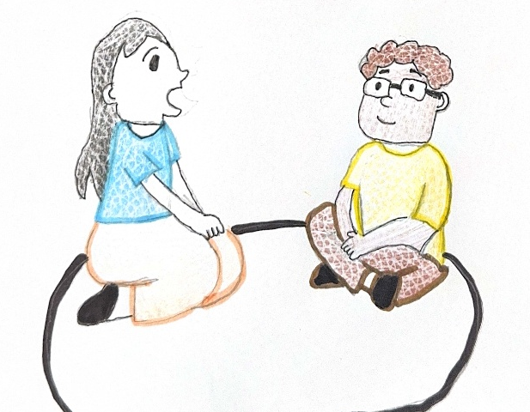
Student voice audit
Rate each area High, Medium or Low based on current evidence, not intention:
classroom participation;
behaviour and restorative processes;
wellbeing support;
school decisions;
curriculum and assessment feedback;
digital and online issues;
safeguarding and complaints processes.
You may pass, pause or step out. Follow local safeguarding procedures. Support details available.
© ACU, 2026

Slide 11
Evidence questions
How are students invited to contribute?
Which students participate most often? Who may be missing?
What happens after students speak?
How do students know their input was heard?
Can students disagree or raise concerns without negative consequences?
You may pass, pause or step out. Follow local safeguarding procedures. Support details available.
© ACU, 2026

Slide 12
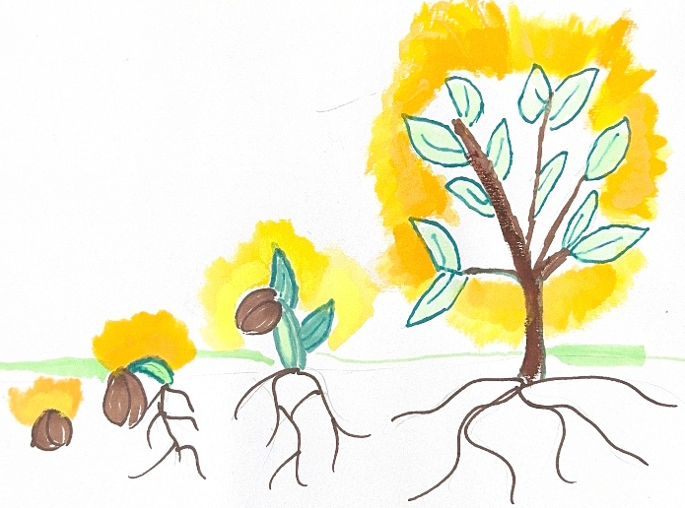
Whole – staff synthesis
Where is student voice strongest?
Where might students feel invisible or unable to disagree?
What evidence do we need directly from students?
You may pass, pause or step out. Follow local safeguarding procedures. Support details available.
© ACU, 2026

Slide 13

The 1% shift
One way I will more intentionally invite student voice is…
You may pass, pause or step out. Follow local safeguarding procedures. Support details available.
© ACU, 2026

