Slide 1
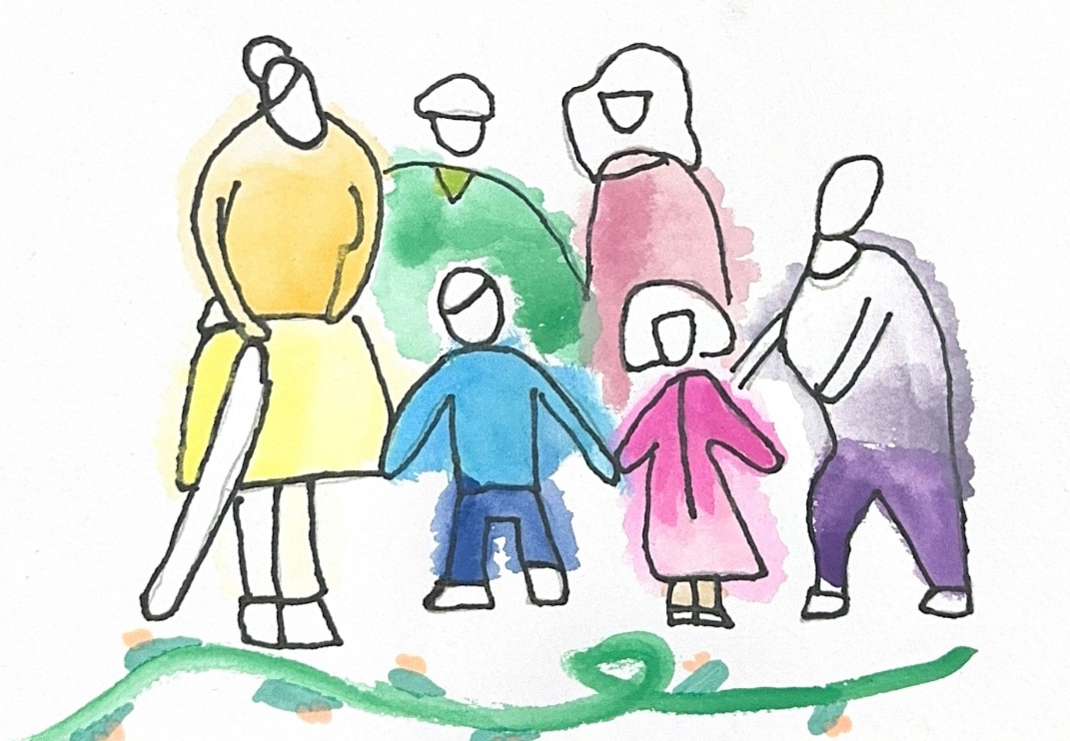

Created for Respectful Relationships
Conversations for Catholic schools
Session 5
Daryl Higgins, Gabby Hunt, Janine Luttick, Jamie Calder
Thursday 5th November 2026
In partnership with
© ACU, 2026

Slide 2
Session 5
From Vision to Practice
-
Culture, implementation and shared commitment
© ACU, 2026

Slide 3
Welcome and participation choices
Participate in ways that are professionally useful and personally safe.
You may pass on any activity, pause, or step out without explanation.
Do not identify students, families, colleagues or yourself through personal disclosures.
This is a professional learning space, not a counselling or disclosure space.
If a concern about a child or young person arises, usual safeguarding and reporting procedures apply.
© ACU, 2026

Slide 4
Group agreements
Speak from your own perspective.
Protect privacy.
Challenge ideas, not people.
Avoid seeking or offering personal disclosures.
Notice the impact of language, not only its intent.
Follow safeguarding processes rather than trying to resolve concerns in the group.
??
© ACU, 2026
Notes:
Facilitator can request if other group agreements would like to be added.

Slide 5
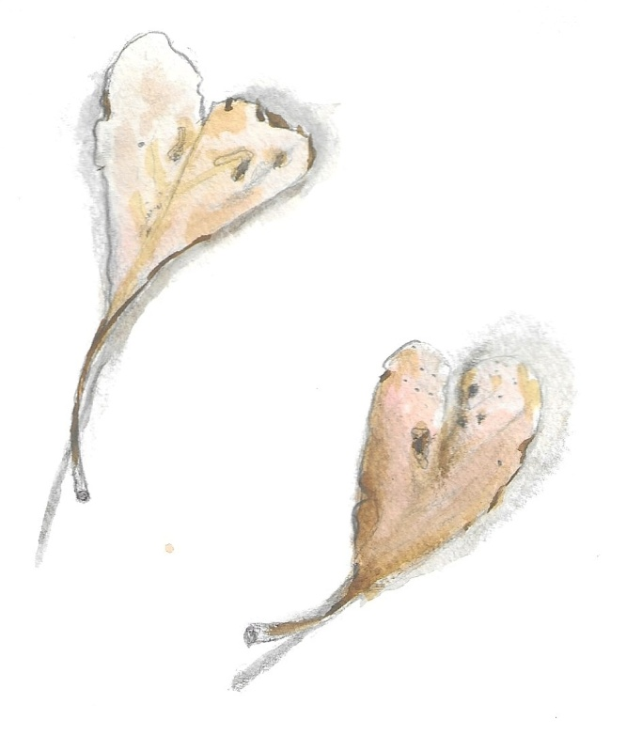
Sensitive content warning & supports
Immediate danger: Call 000.
1800RESPECT: 1800 737 732.
Lifeline: 13 11 14.
13YARN: 13 92 76.
Employee Assistance Program: [SCHOOL TO INSERT].
Internal support contact: [SCHOOL TO INSERT].
Reporting concerns: [SCHOOL TO INSERT PROCESS/LINK].
Notes:
***SCHOOLS ARE ENCOURAGED TO POPULATE THIS SLIDE FOR THEIR CONTEXT***
Today’s session deals with relationships, consent, safety and experiences of harm. You are invited to participate in ways that are professionally useful and personally safe. You may pass on any activity, step out without explanation, or speak with our nominated support person. Please do not share personal stories about students, colleagues or yourself in a way that identifies anyone. This is a professional learning space, not a disclosure or counselling space. If a concern about a child or young person arises, our usual safeguarding and reporting procedures apply.

Slide 6
Session outcome
By the end of this session, we will translate the series into a small number of concrete, owned and reviewable actions.
You may pass, pause or step out. Follow local safeguarding procedures. Support details available.
© ACU, 2026

Slide 7
Our core question
What will we do differently in everyday practice?
You may pass, pause or step out. Follow local safeguarding procedures. Support details available.
© ACU, 2026
Notes:
This final session brings the series into practice. We have explored dignity, relationality, Jesus’ model of love, voice, power and safeguarding. The question now is concrete: what will this look like tomorrow, and what will we commit to doing consistently as a school?

Slide 8
What we have explored
Dignity and flourishing.
Human beings as relational.
Jesus’ model of healing, restoring and accompanying.
Voice, agency, vulnerability and power.
Safeguarding as both structure and lived culture.
You may pass, pause or step out. Follow local safeguarding procedures. Support details available.
© ACU, 2026

Slide 9

Watch the video
You may pass, pause or step out. Follow local safeguarding procedures. Support details available.
© ACU, 2026
Notes:
Video link:
https://www.youtube.com/watch?v=eQ-bYkLabUs

Slide 10
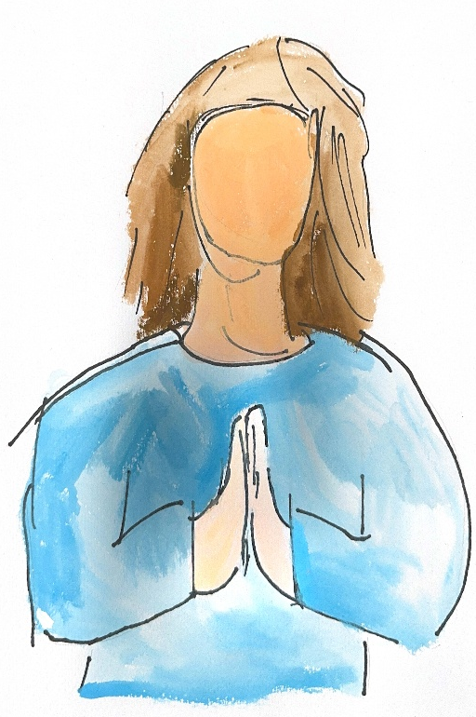
Pause and reflect
Where in my daily practice do I already contribute to a culture of dignity?
Where might I unintentionally undermine it?
What is one change within my influence?
You may pass, pause or step out. Follow local safeguarding procedures. Support details available.
© ACU, 2026
Notes:
Please respond to these questions on the worksheet provided. Respond only at a professional level. Do not name or describe identifiable students, families, colleagues or personal experiences. You may leave any section blank.

Slide 11
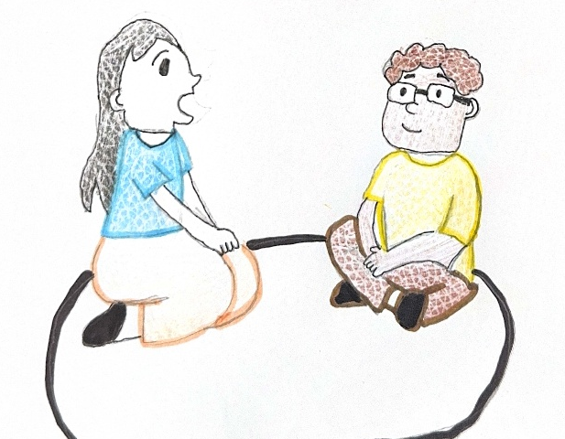
From Idea to Action
Choose one area:
Classroom culture
Staff-student interactions
Student-student relationships
Curriculum delivery
Student voice
Leadership and policy alignment
You may pass, pause or step out. Follow local safeguarding procedures. Support details available.
©ACU, 2026
Notes:
Use the From Idea to Action worksheet. We are looking to convert one priority into a specific, owned and reviewable action rather than an unmanageable wish list. Choose one area from this list and mark it on your sheet.

Slide 12
Build one concrete action
What are we already doing well?
What is one gap or inconsistency?
What is one realistic action this term?
Who needs to own or support it?
What evidence would show progress?
When will it be reviewed?
You may pass, pause or step out. Follow local safeguarding procedures. Support details available.
© ACU, 2026
Notes:
Use the From Idea to Action worksheet to describe the current state.

Slide 13
Test the action
Is it specific and observable?
Is it within the group’s influence or clearly escalated to the right owner?
Does it strengthen student dignity, safety, voice or learning?
Can progress be evidenced?
Is there a named review point?
You may pass, pause or step out. Follow local safeguarding procedures. Support details available.
© ACU, 2026
Notes:
Use the From Idea to Action worksheet to define one realistic action, the implementation steps and how you will document the evidence of your progress. There is also an implementation checklist that could be useful for you to use.

Slide 14
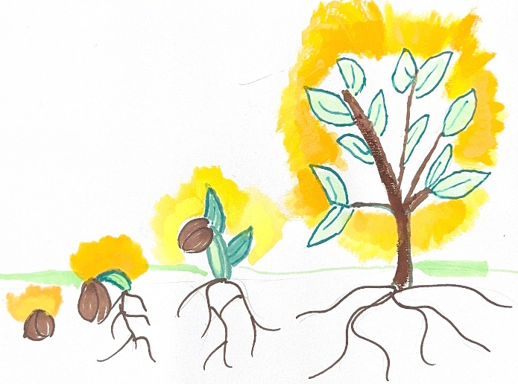
Whole – staff synthesis
Which actions are within immediate staff influence?
Which require leadership, policy or curriculum planning?
What should be prioritised, owned and reviewed?
You may pass, pause or step out. Follow local safeguarding procedures. Support details available.
© ACU, 2026
Notes:
Please answer these questions on the accompanying worksheet.

Slide 15

Practical takeaway – Start, stop, continue
One thing I will START, STOP or CONTINUE is…
One relationship, one moment and one deliberate choice at a time, we build a culture where dignity, safety and respectful relationships are lived.
You may pass, pause or step out. Follow local safeguarding procedures. Support details available.
© ACU, 2026
Notes:
Thank you for engaging thoughtfully. This work is not about having every answer or achieving perfection. It is about taking the next faithful, professionally responsible step together. Please complete your commitment card. The themes gathered today will be used only for the stated school improvement purpose, and we will communicate the next review point.

Slide 16
One relationship, one moment and one deliberate choice at a time, we build a culture where dignity, safety and respectful relationships are lived.
From session to implementation
Listen: gather de-identified staff themes and approved student and family input.
Map: identify where CRRE appears across school life.
Prioritise: select a small number of high-impact gaps.
Act: assign owners, resources, milestones and communication.
Review: examine implementation evidence and lived experience.
Sustain: embed agreed practice in induction, professional learning and monitoring.
You may pass, pause or step out. Follow local safeguarding procedures. Support details available.
© ACU, 2026
Notes:
Thank you for engaging thoughtfully. This work is not about having every answer or achieving perfection. It is about taking the next faithful, professionally responsible step together. Please complete your commitment card. The themes gathered today will be used only for the stated school improvement purpose, and we will communicate the next review point.

